Slide 1
Thermal Monitoring System
ECE 411 Practicum Project
By: Dmitriy Leonchik, Jose Aguliar, Mike Meza, and Rob Newcomb
December 11, 2014
Rev 6
Notes:
Jose

Slide 2
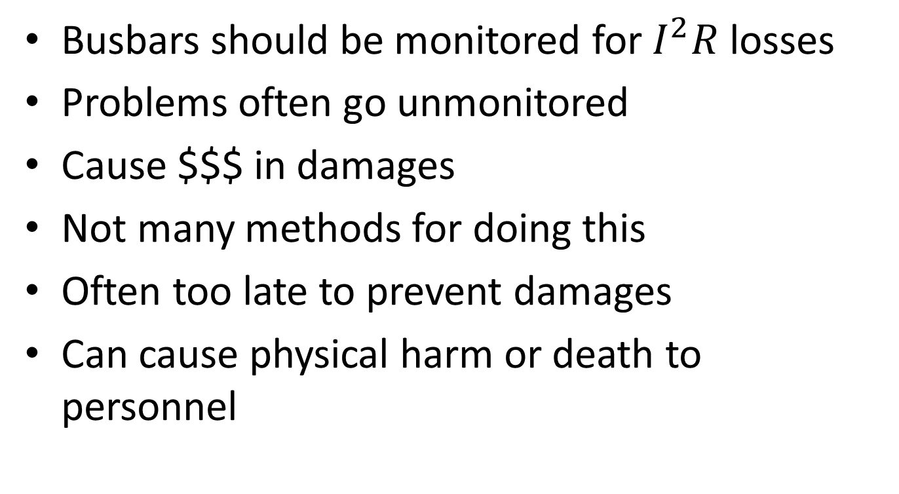
Problem
Busbars should be monitored for $I^{2}R$ losses
Problems often go unmonitored
Cause $$$ in damages
Not many methods for doing this
Often too late to prevent damages
Can cause physical harm or death to personnel
Notes:
Jose

Slide 3
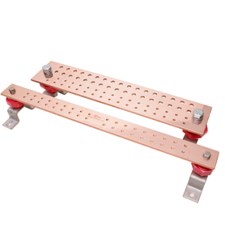
Busbars!
Busbar: Long metal conductor used to supply a steady flow of power to other electrical equipment. Often lamped, or welded connections, But most of the time bolted for maintenance If necessary.
Enclosure: These busbars are located in enclosures with limited visual appearance of the busbars themselves. Often there are simply no visual in the enclosure.

Slide 4
Motivation
Detecting a fault on a busbar early can reduced downtime
Catch problem/over heating early stage
Prevent $$$ lost
Reduce effort to inspect dangerous busbar enclosure
Prevent harm to work personnel
Notes:
Jose

Slide 5
Objective
Design a system that will monitor the current and temperature of a busbar
System will be a prototype
System will only be functional for a small busbar system ( 12x5’’)
A small test jig will be used for demo purposes
Notes:
Jose

Slide 6
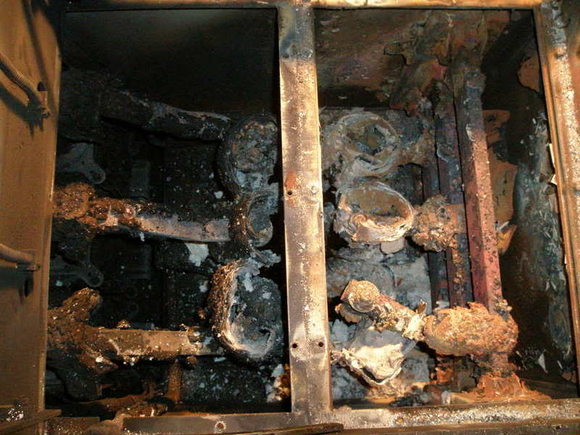
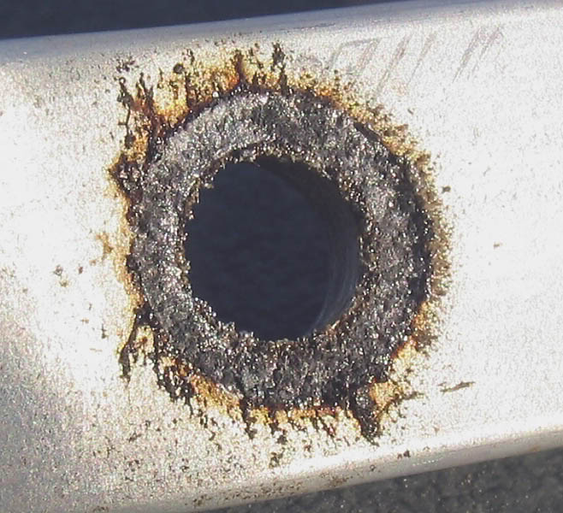
Busbar Damages

Slide 7
Alternatives
IR gun sensor
Requires personnel to manually measure temperature through sight glass
Cannot reach all sections of busbar system
Thermal Imaging
Requires personnel to manually measure temperature through sight glass
Cannot reach all sections of busbar system
Notes:
Jose

Slide 8
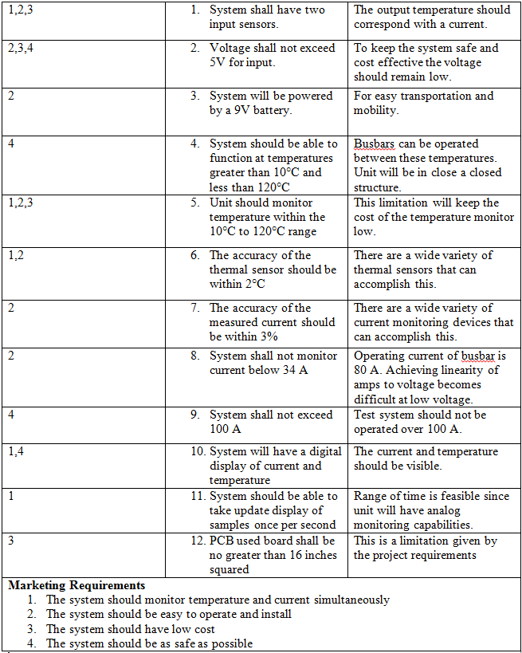
Requirements
Product Design Specifications
Rev 5
System Should WORK!
Notes:
Rob

Slide 9
Approach
Research
Thermal Sensors
Microprocessors
Current Transformers
EagleCAD
Displays
Arduino IED
Build
ATMega 328P
IR - MLX 90614
CT – AL 101
VR – 7805
LCD – ST7066
Design
Choose parts
Draw Schematics
Document
Purchase Parts
Test
PCB Connections
Each component separately
Build system one component at a time
System
Notes:
Rob

Slide 10
Design
Hardware
CT
IR
LCD
Rectifier
Resistor bank
Capacitors (10uF, 0.1uF)
Resistors (47k, 10k)
Voltage Regulator
Software
Arduino IDE w/ Smart Cable
IR code
CT code
LCD code
Integration of all code
Notes:
Mike

Slide 11
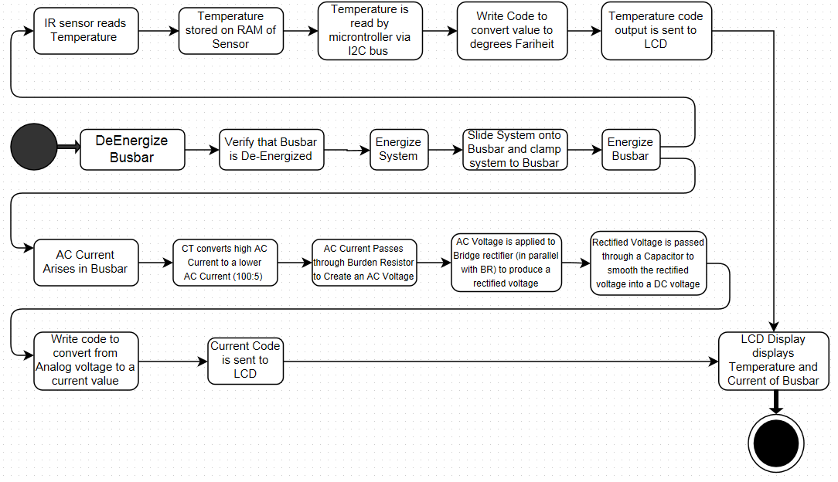
Design- Activity View
Notes:
Mike

Slide 12
Design- CT Algorithm
Notes:
Dima

Slide 13
Design- Alternatives
Possible alternatives is link the PCB board to a PLC
Connect PLC to relays for a fault scenario
OR alternatives connected to a switch gear.
Integrate Possible program to integrate high current/temperature.
Measure torque of bolts.
Motion/vibration sensor
Fiber optic cable
Use Three Piece Enclosure
Notes:
Dima

Slide 14
Design - Trade-offs
Price
Set budget of $200
Material
Appearance
Prototype only
Ease of Implementation
Has to work with Test Jig
Limited research needed for code
Notes:
Dima

Slide 15
Implementation
Major Components
VR: 7805
LCD: ST7066
IR: MLX 90614
CT: AL – 101
Rectifier: VH848
Notes:
Mike

Slide 16
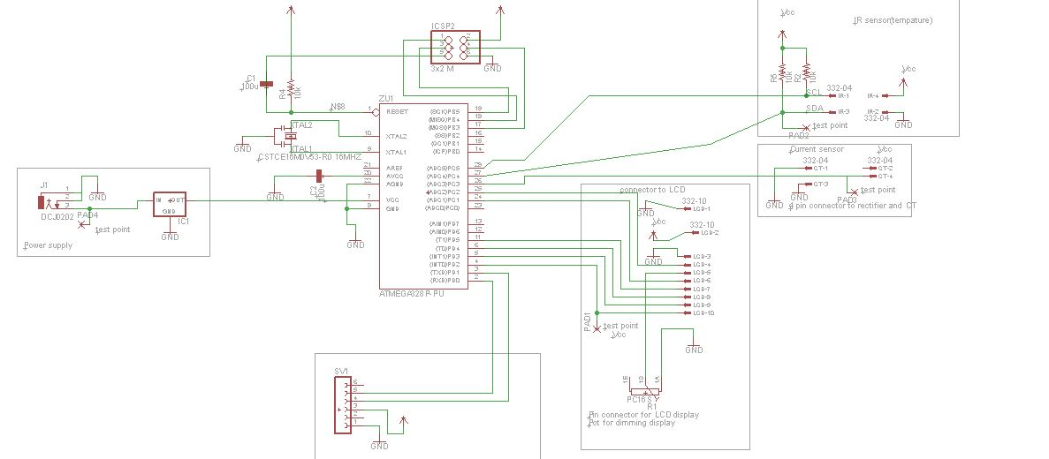
Implementation - Schematic
Notes:
Mike

Slide 17
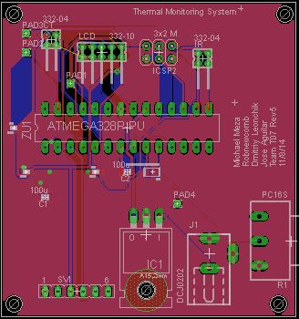
Implementation – Board Layout
Notes:
Mike

Slide 18
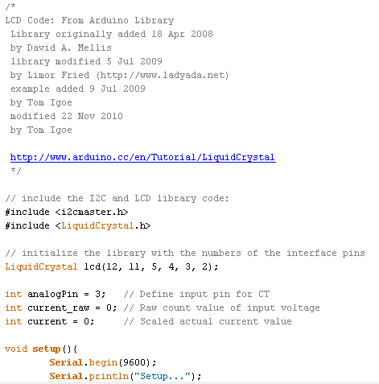
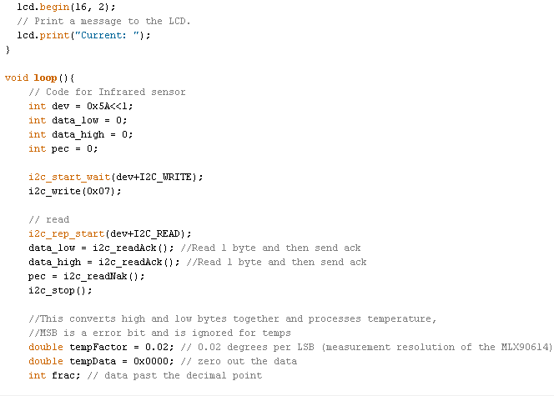
Implementation- Code
Notes:
Dima

Slide 19
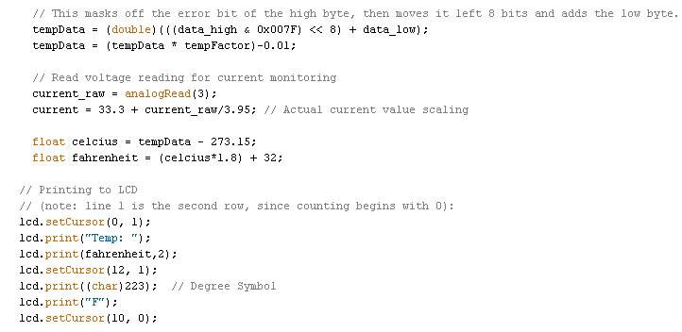
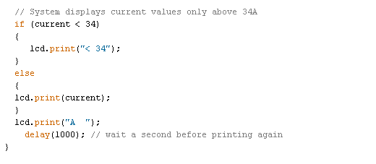
Implementation- Code Continued
Notes:
Dima

Slide 20
IP and Prior Work
Basic idea of system is a capstone project
Basic IR code obtained from http://bildr.org/?s=mlx90614
Took basic code to read temperature and modified it to work with out system
Idea came from DR. Bass for the project
Grad student is working on a PLC version for capstone we made a microcontroller prototype
Notes:
Mike

Slide 21
Testing
Component Tests
IR
CT
LCD
Microcontroller
Power
Blinking Light
Hello World
IR to LCD
CT to LCD
IR and CT to LCD
Functional Tests
PCB
Power and VR
LCD
IR
CT
Acceptance Test
System Test
Temperature Range
Current Range
Notes:
Rob

Slide 22
Results
Power supply Pins backwords
Power source on PCB not grounded
Pin 28 not connected to SCL of IR
Pin 27 connected to CT instead of SDA of IR
Pin 26 not connected, should connect to CT
Pin 17 connected to IR, should be connected to E for LCD
Pin 16 connected to IR, should not be connected
Capacitors is series from Power
No capacitor for RESET
Notes:
Rob

Slide 23
Contributions
Prepare documentation – Rob
Review documentation – All Team members
Created GitHub account and uploaded documentation - Rob
Research microcontroller and test – Mike and Dmitriy
Research and test CT – Jose and Rob
Research and test IR – Dmitriy and Rob
Design layout – Mike
Design board layout – Mike

Slide 24
Contributions
Research/wrote CT and IR code - Dmitriy
Write test plans – All team members
Design Enclosure – Jose
Build and Test prototype – Rob and Dmitriy
Build, Test, and assemble final product – All team members

Slide 25
Lessons Learned
Better to have a PDS before Implementing a Project
Have WBS before starting project so it is clear what each team member needs to do and by when
Research each component thoroughly prior to working on a Project
Be open to design changes
Notes:
Jose

Slide 26
Lessons Learned
Have multiple people with overlapping skillsets
Have Design Reviews at all stages
Communication between members is key
Notes:
Jose

